Slide 1

Chatbot for mental health support

Slide 2
Group 30
Name | Student ID
Jeet Ambaliya | 40221712
Neha Sudhir Himane | 40219032
Prince Ghoghari | 40216962
Hardik Amareliya | 40216854
GitHub : SPM_PROJECT_GROUP_30

Slide 3
agenda
Problem Statement
Market Analysis
Feasibility Study
Software Solution Proposal
Software Solutions Project Plan
Risk Assessment and Mitigation
Software Development Budget

Slide 4

Problem statement
Mental health issues are escalating globally, yet traditional therapeutic support faces challenges in accessibility and scalability.
The integration of chatbots into mental health care offers a promising solution by providing immediate, accessible, and personalized support, but requires innovative approaches to fully address the complexities of mental wellness.
Stakeholders:
Individuals Experiencing Mental Health Issues
Mental Health Professionals
Healthcare Institutions
Employers

Slide 5
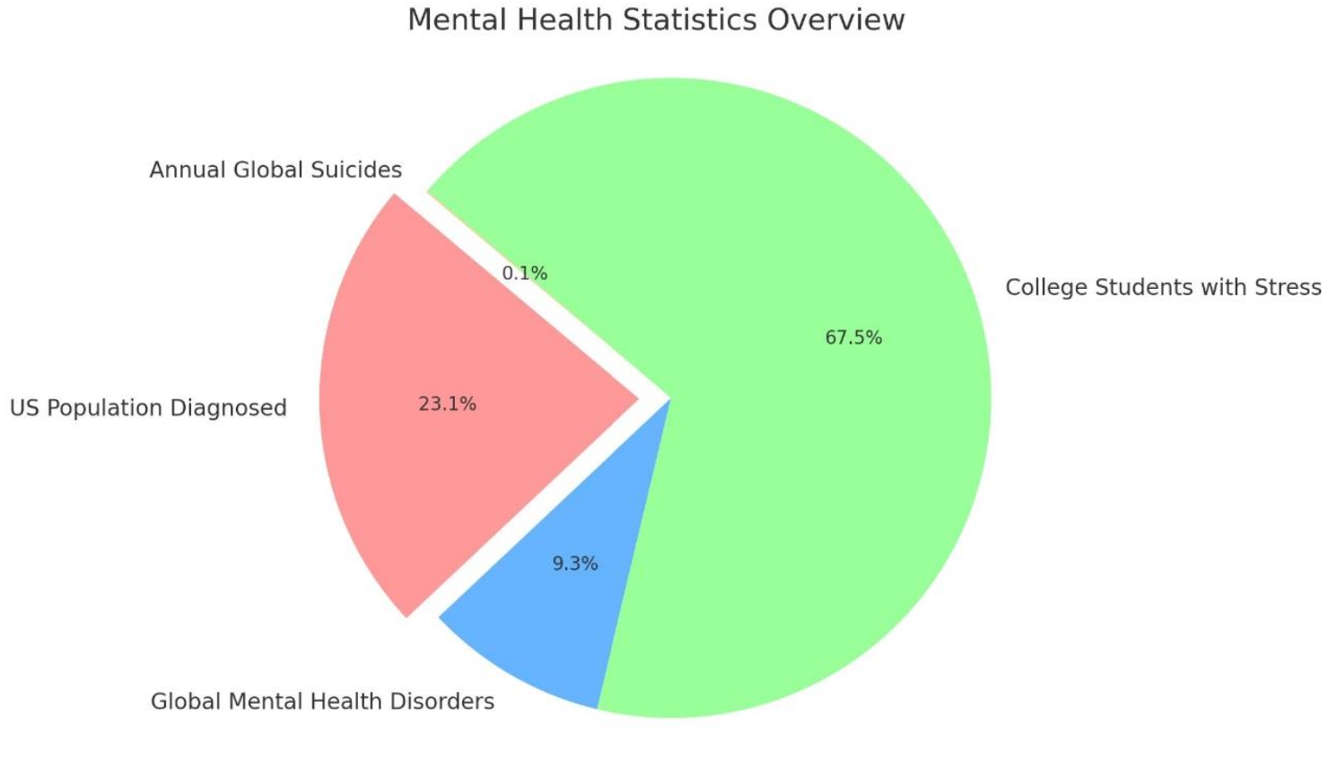
Market analysis
Target Audience Insight
Mental Health Landscape
Competitor Overview
Market Opportunities & Challenges

Slide 6
Feasibility Study
Technical Viability: Confirms the readiness of AI, ML, and NLP technologies to develop an effective mental health chatbot.
Operational Adaptability: Evaluates integration with current healthcare practices, highlighting the chatbot's role in enhancing therapeutic interventions.
Challenges and Benefits: Identifies potential hurdles like technology adoption and privacy concerns while underscoring benefits such as reduced wait times and consistent support.
Economic Viability: Projects a favorable ROI, considering development costs against the potential for improved patient access and outcomes.

Slide 7
Software Solution Proposal
MindMate Chatbot Overview: An innovative solution leveraging AI for personalized mental health support.
Key Features & Functionalities: Guided conversations, self-assessment tools, crisis management.
Diverse Use Cases: Tailored support for students, individuals assessing their mental state, and those in crisis.
Benefits & Impact: Offers immediate support, ensures privacy, enhances patient care, and promotes workplace well-being.

Slide 8
Software Solution Project Plan
Key Milestones: Project kickoff, completion of requirements, chatbot design finalization, alpha version release, and successful UAT completion.
Deliverables: Project charter, requirements document, design mockups, developed chatbot features, and performance analysis report.
Human & Technological Resources: Involves project managers, developers, QA engineers, support teams, and utilizes SDKs, IDEs, and cloud hosting services.
Critical Dependencies: Stakeholder feedback, AI/ML and NLP technology availability, and integration with healthcare systems.

Slide 9
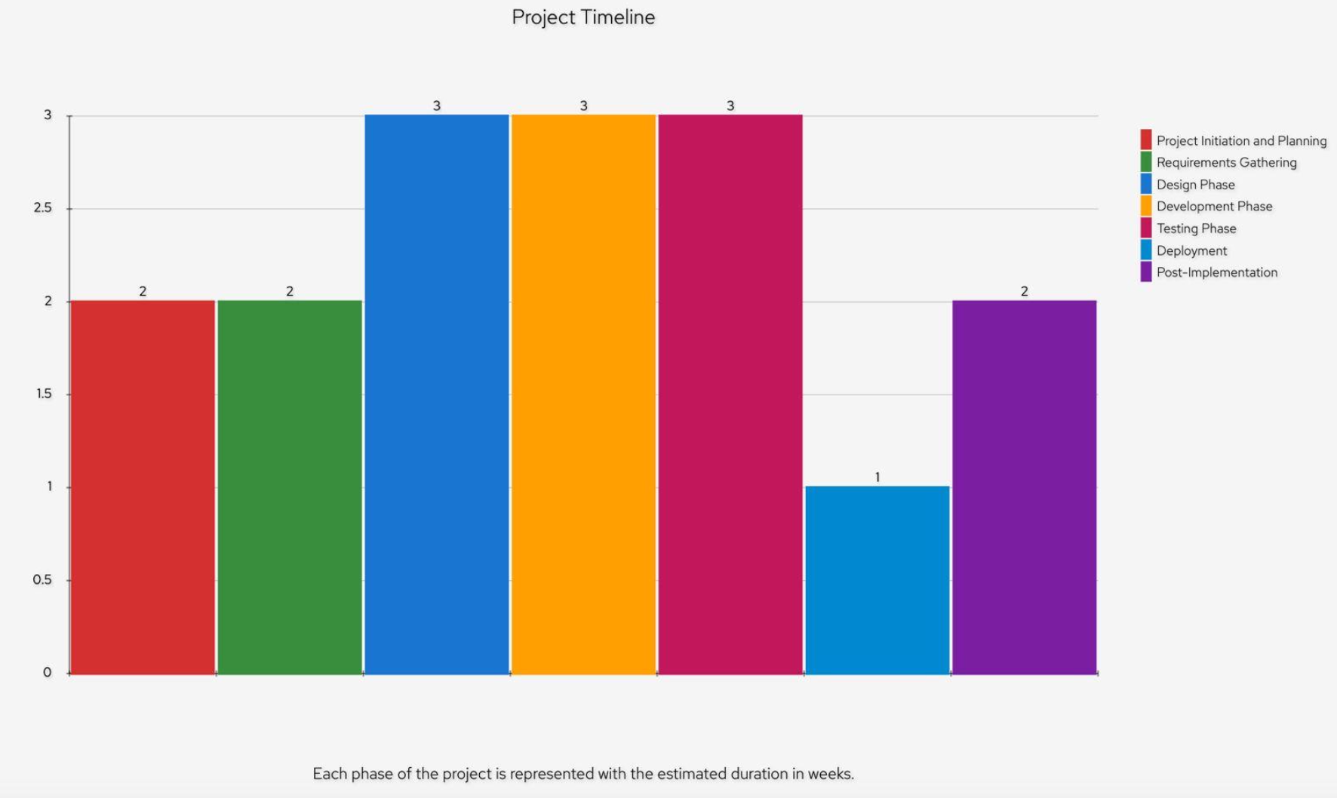
Cont…
Project Phases:
Initiation
Requirements
Design, Development
Testing
Deployment
Post-Implementation review

Slide 10
Risk Assessment and Mitigation Plan
Risk Categories
Technical
AI/ML performance
System integration
Data security
Operational
Adoption resistance,
User engagement
Regulatory compliance

Slide 11
Cont…
Mitigation Strategies
Iterative testing for AI/ML
Robust integration planning
Comprehensive user onboarding
Adherence to data privacy regulations
Clear budgeting with contingencies.

Slide 12
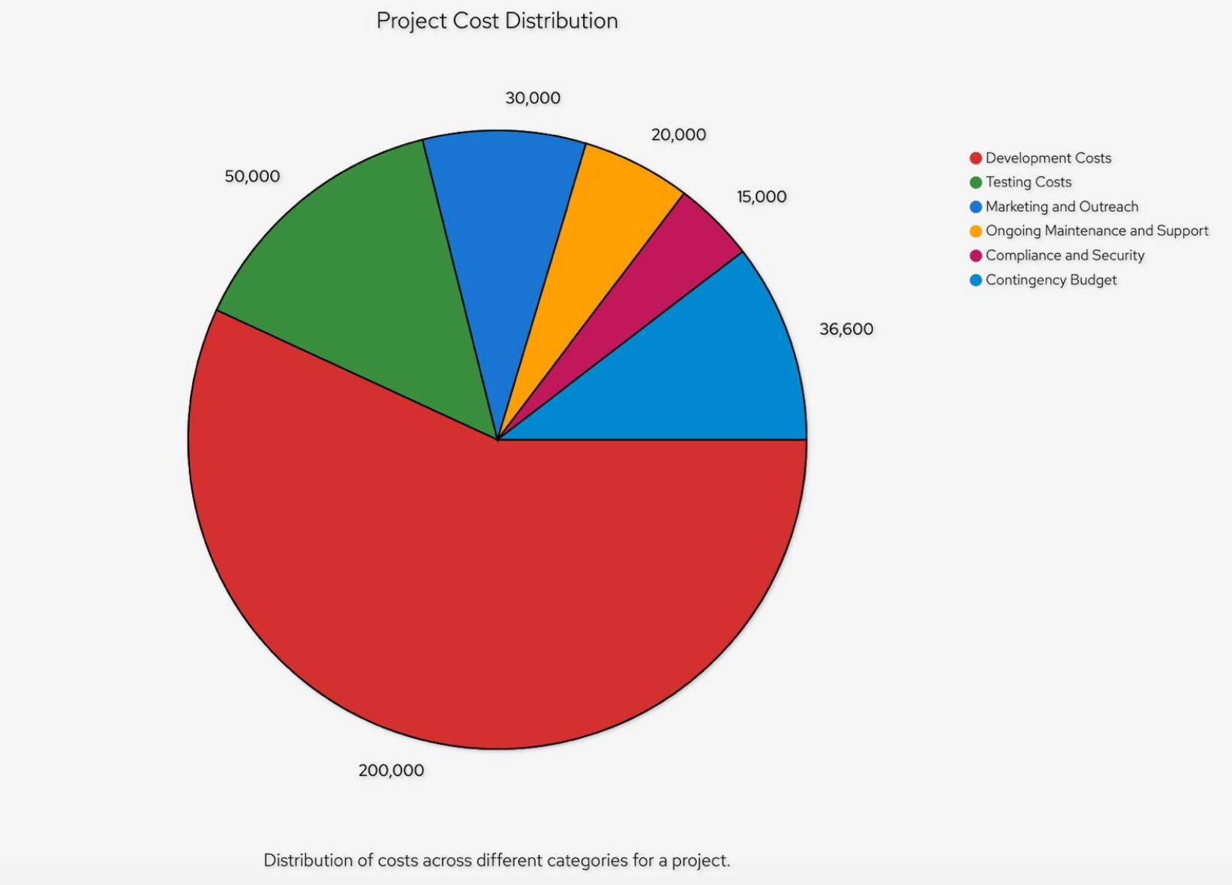
Software Development budget
Comprehensive Budget Overview
Human Resources & Technology
Marketing & Outreach
Contingency Plan
Ongoing Support

Slide 13
Thank you

